Slide 1
Mesh Analysis Section 3.1, 3.2, 3.4, 3.5
Md. Shafqat Talukder Rakin
Lecturer, Department of CSE,
United International University
Email id : shafqat@cse.uiu.ac.bd
Courtesy: Rifat Bin Rashid

Slide 2
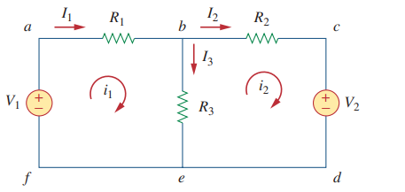
Loop and Mesh
Loop: Any closed path
Mesh : A mesh is a loop which does not contain any other loops within it

Slide 3
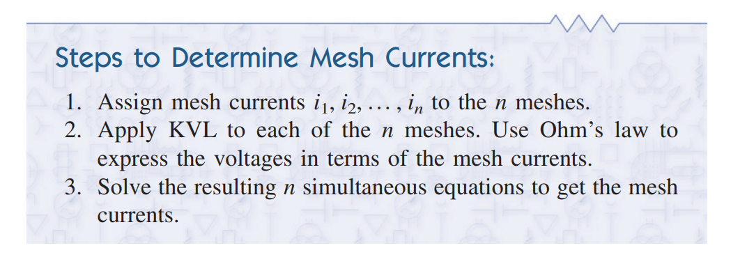
Mesh Analysis
Goal : Finding the mesh Currents.

Slide 4
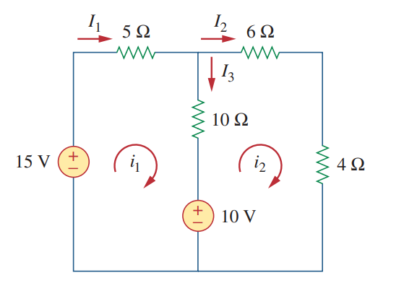
Math Problem Practice:
For the circuit in Fig , find the branch currents I₁, I₂, I₃ and using mesh analysis.
Reference: Sadiku_Example_3.5

Slide 5
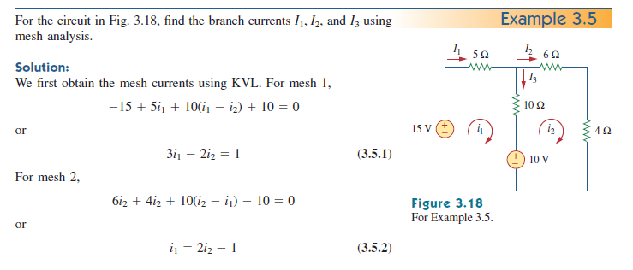
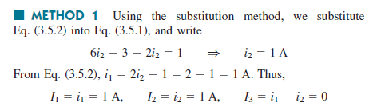
Math Problem Practice:
Reference: Sadiku_Example_3.5

Slide 6
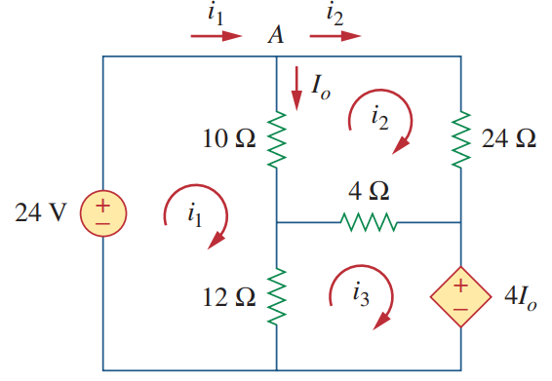
Math Problem Practice:
Use mesh analysis to find the current I_{o} in the circuit of Fig. below
Reference: Sadiku_Example_3.6

Slide 7
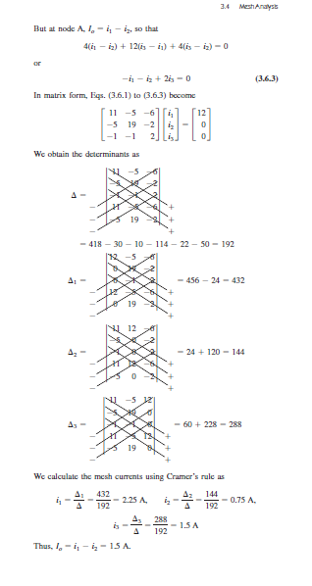
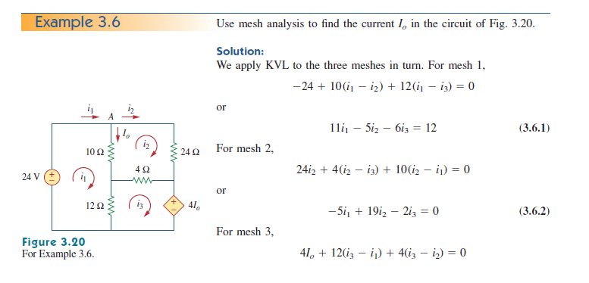
Math Problem Practice:
Reference: Sadiku_Example_3.6

Slide 8
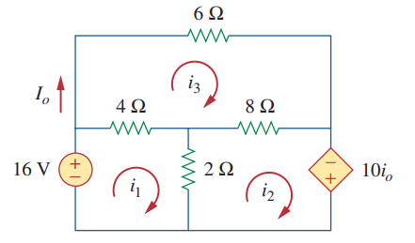

Math Problem Practice:
Use mesh analysis to find the current I_{o} in the circuit of Fig. below
Reference: Sadiku_Practice_Problem_3.6

Slide 9
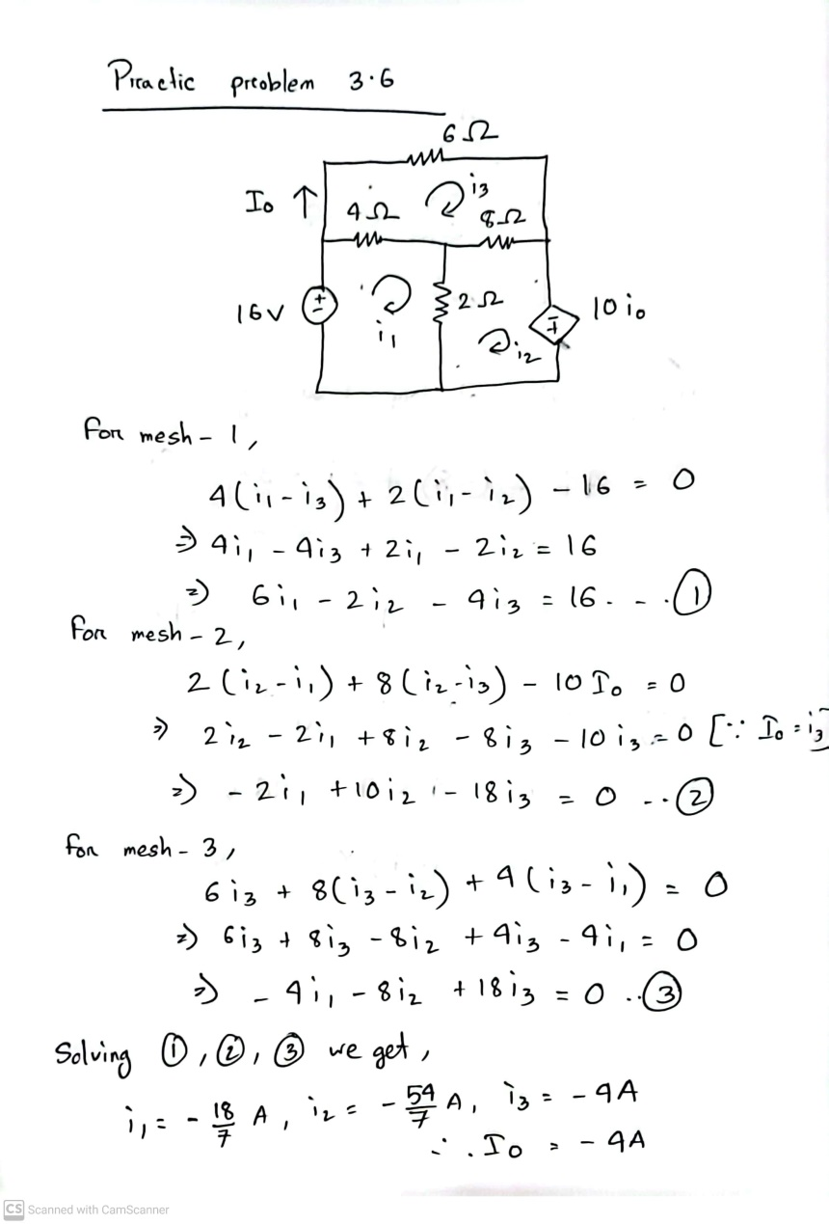
Math Problem Practice:
Reference: Sadiku_Practice_Problem_3.6

Slide 10
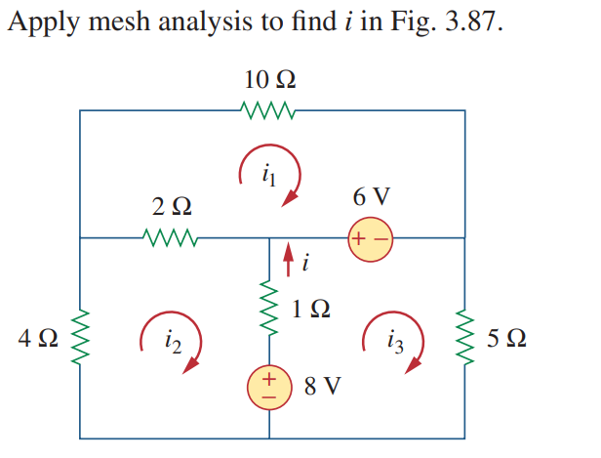
Math Problem Practice:
Reference: Sadiku_Exercise_Problem_3.41

Slide 11
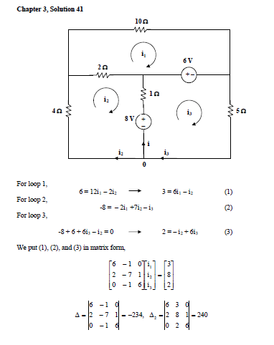
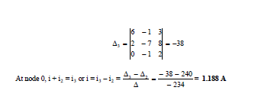
Math Problem Practice:
Reference: Sadiku_Exercise_Problem_3.41

Slide 12
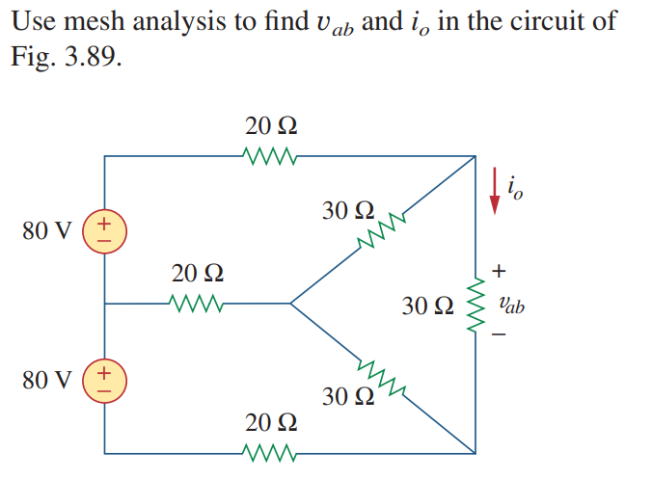
Math Problem Practice:
Reference: Sadiku_Exercise_Problem_3.43

Slide 13
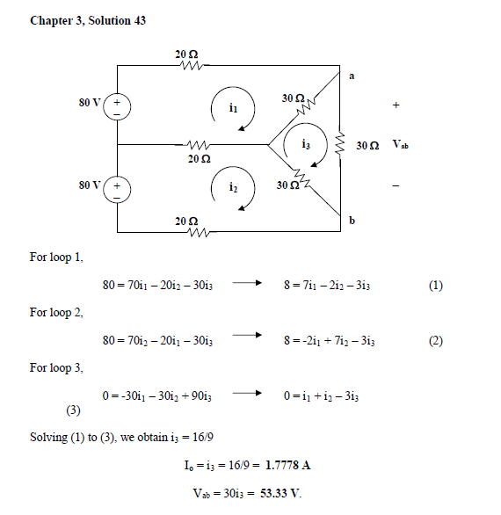
Math Problem Practice:
Reference: Sadiku_Exercise_Problem_3.43

Slide 14
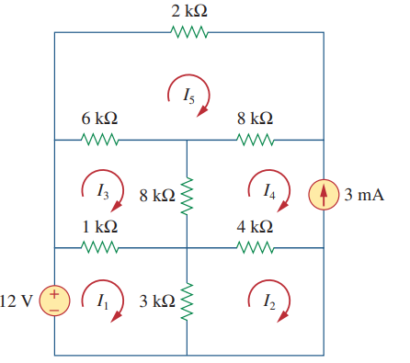
Math Problem Practice:
Find the mesh currents.
Reference: Sadiku_Exercise_Problem_3.53

Slide 15
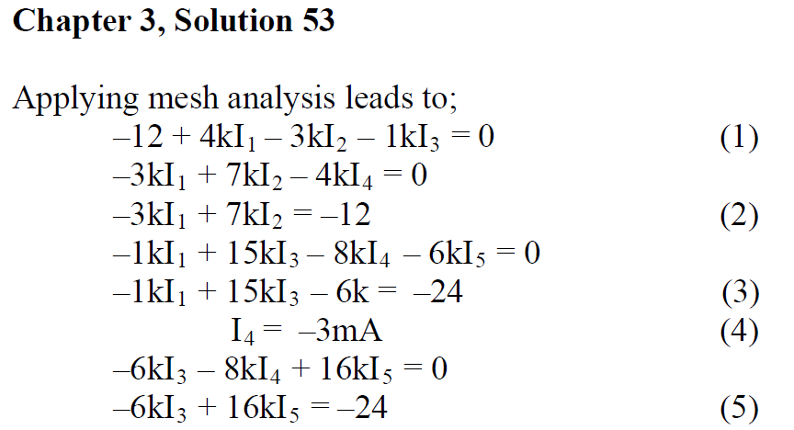
Math Problem Practice:
Reference: Sadiku_Exercise_Problem_3.53

Slide 16
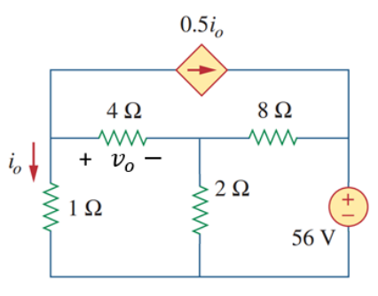
Math Problem Practice:
Summer 2022
Calculate the currents through all the resistors using mesh analysis method and find vo.

Slide 17
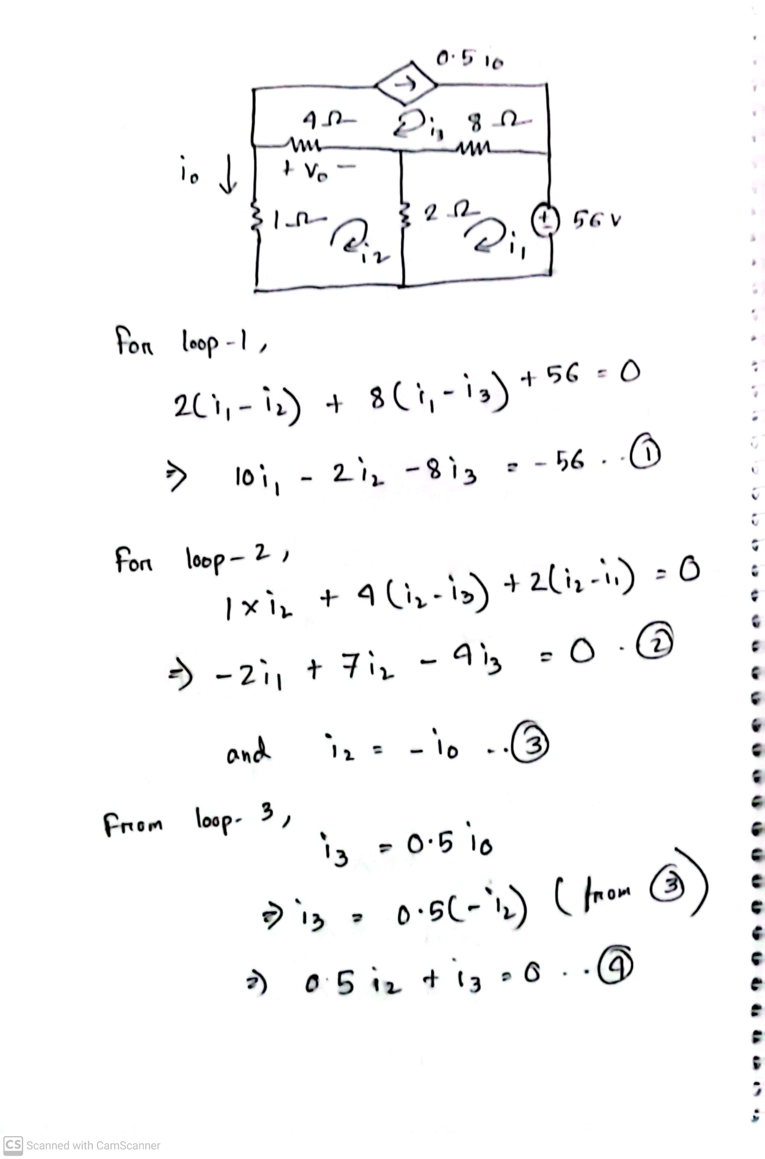
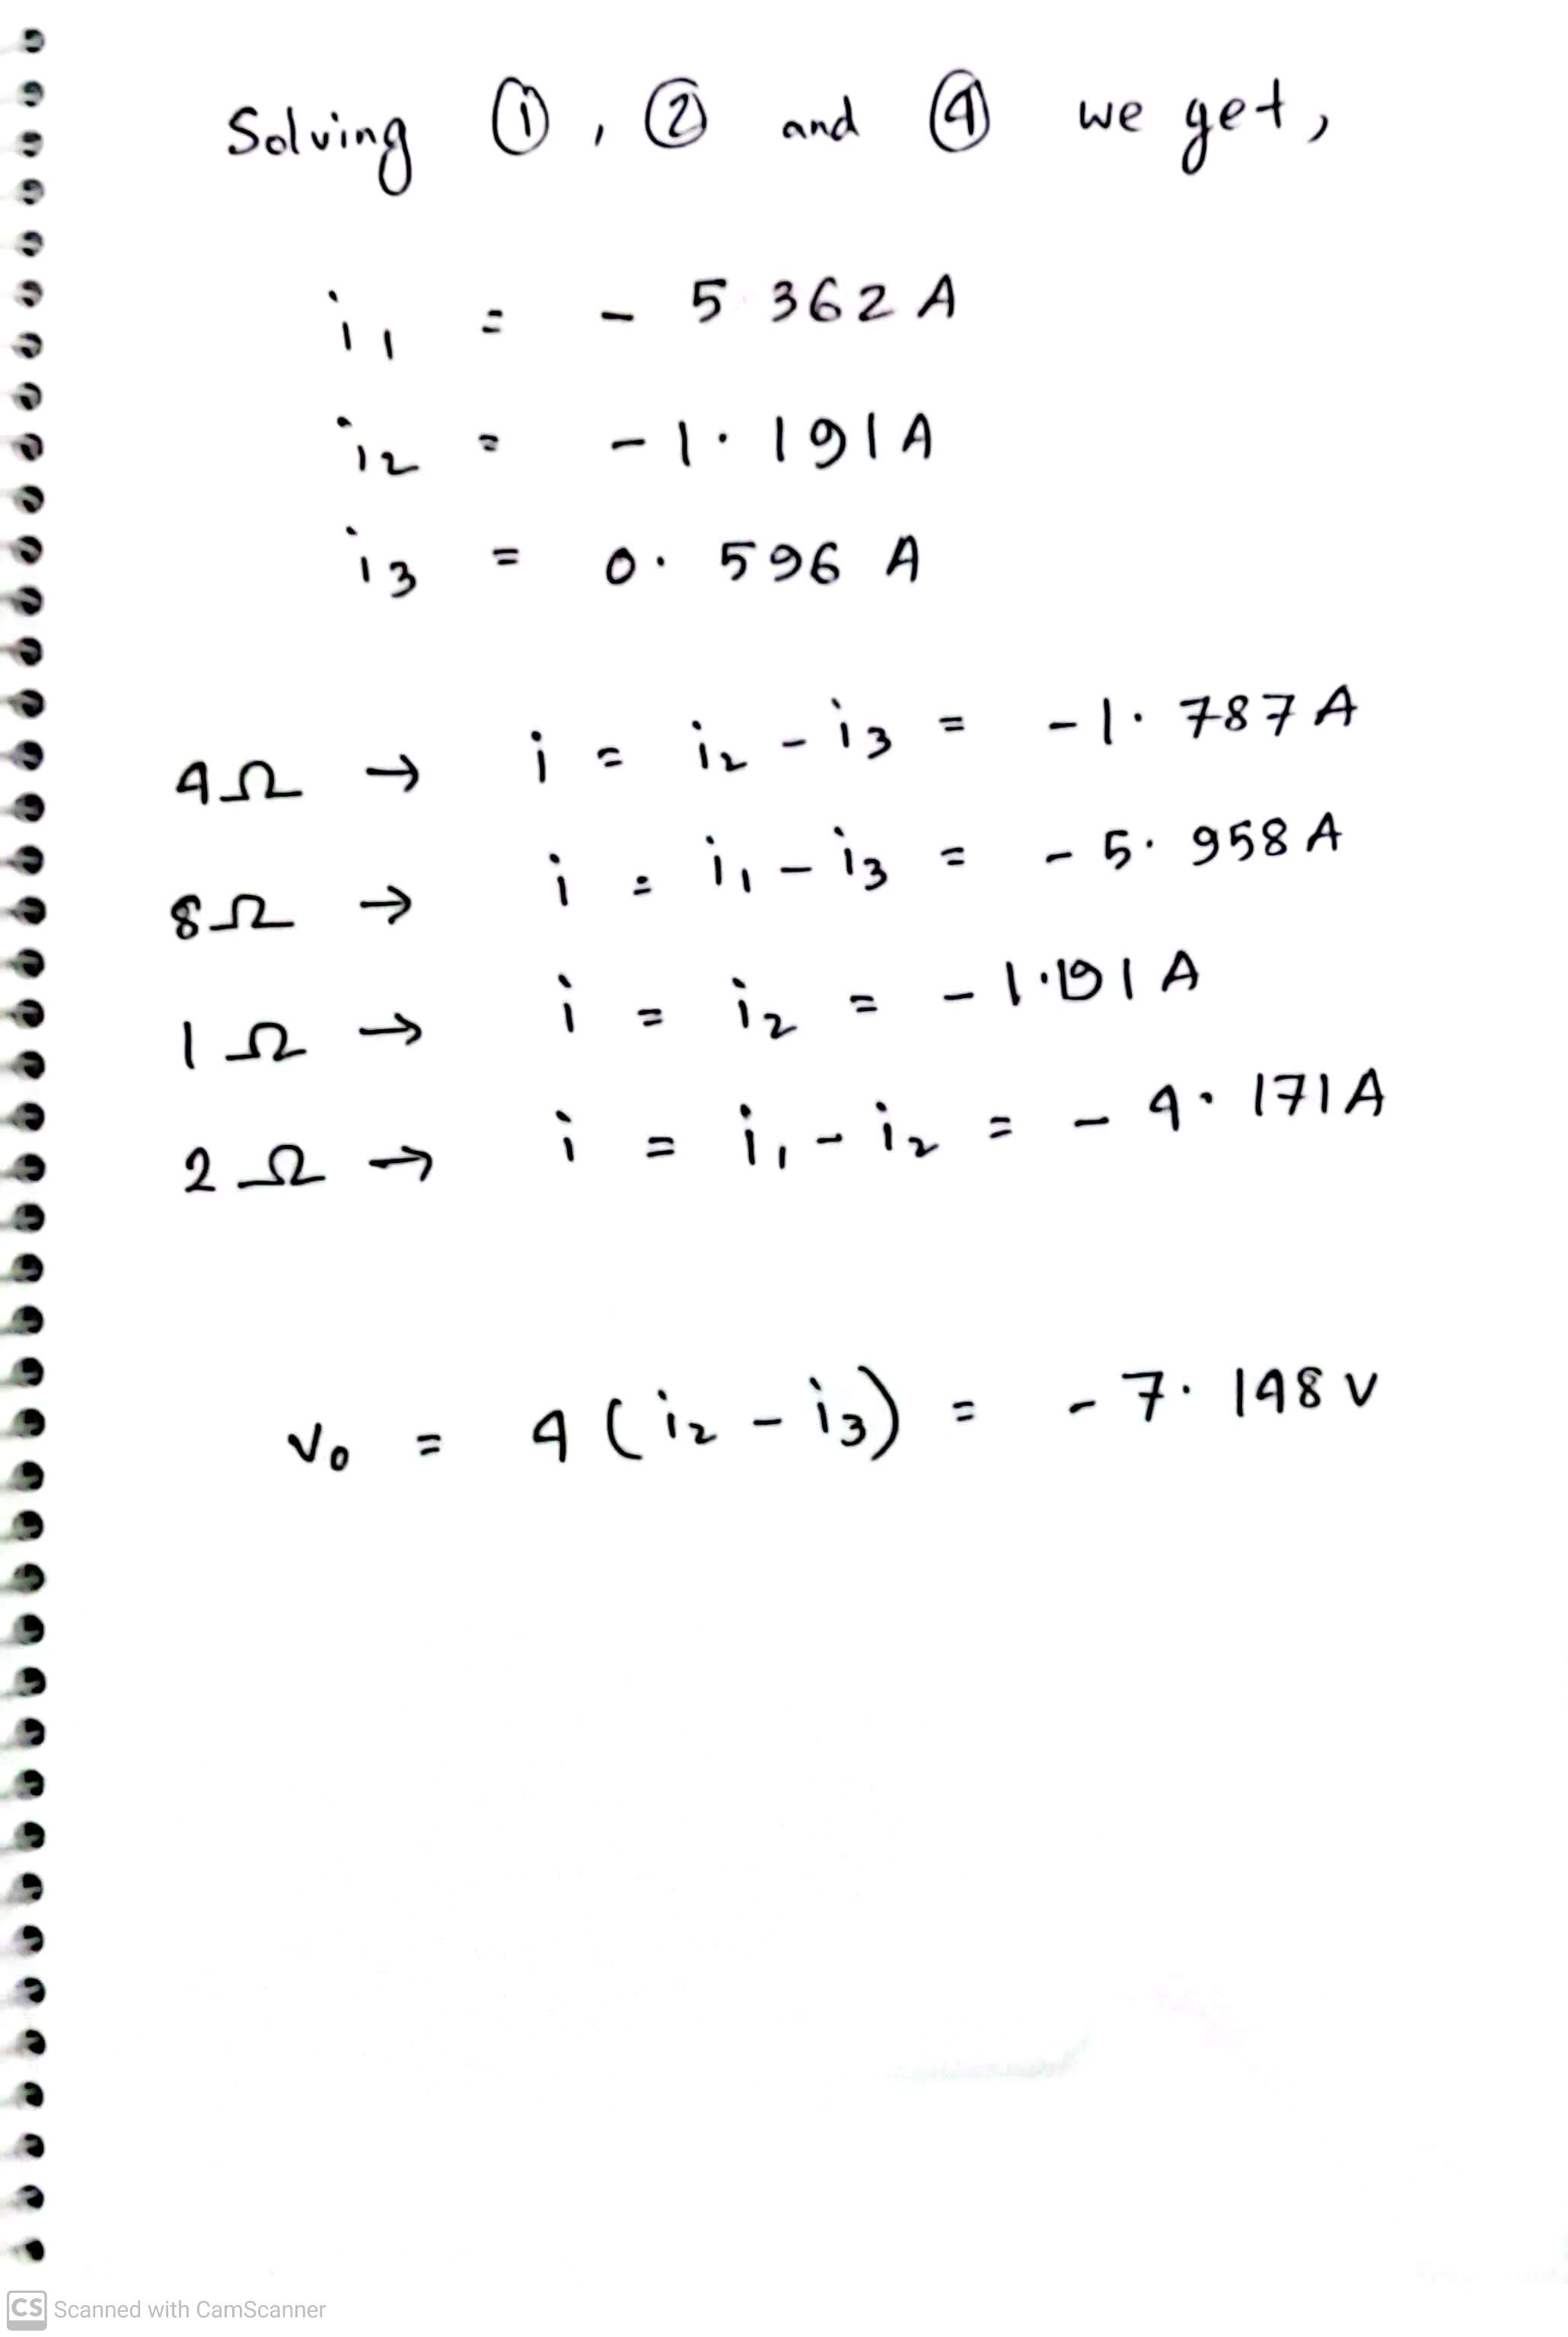
Math Problem Practice:
Summer 2022

Slide 18
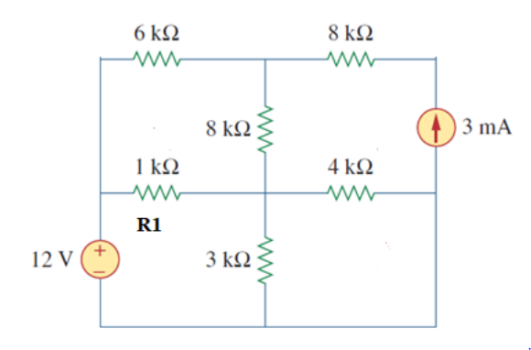
Math Problem Practice:
Fall 2022
(a) Determine the currents in all resistors using Mesh Analysis.
(b) Determine the power absorbed the in R1 resistor.

Slide 19
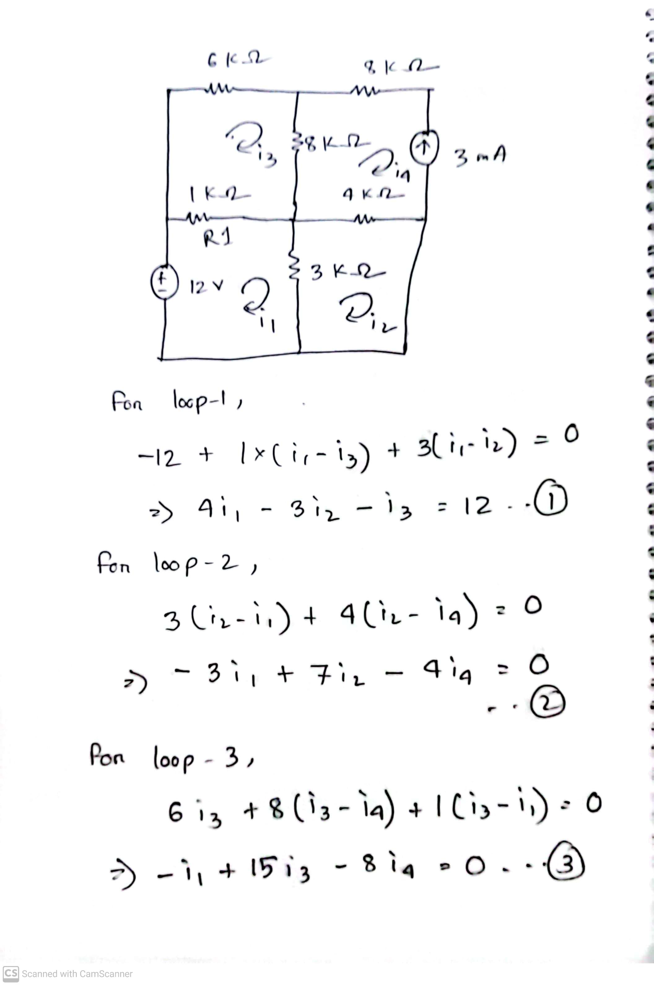
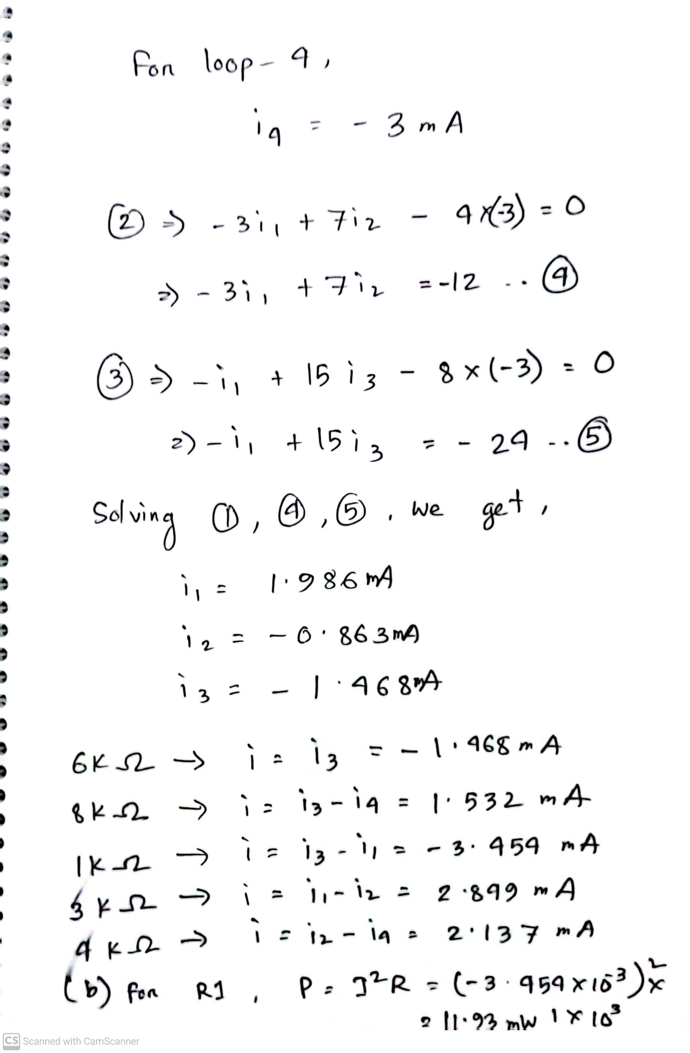
Math Problem Practice:
Fall 2022

Slide 20
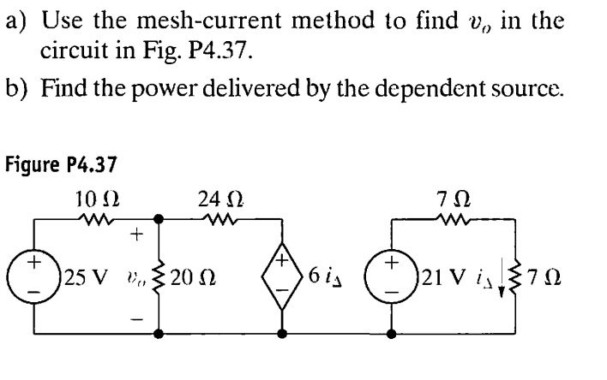
Math Problem Practice:
Reference: Nilsson_Exercise_Problem_4.37

Slide 21
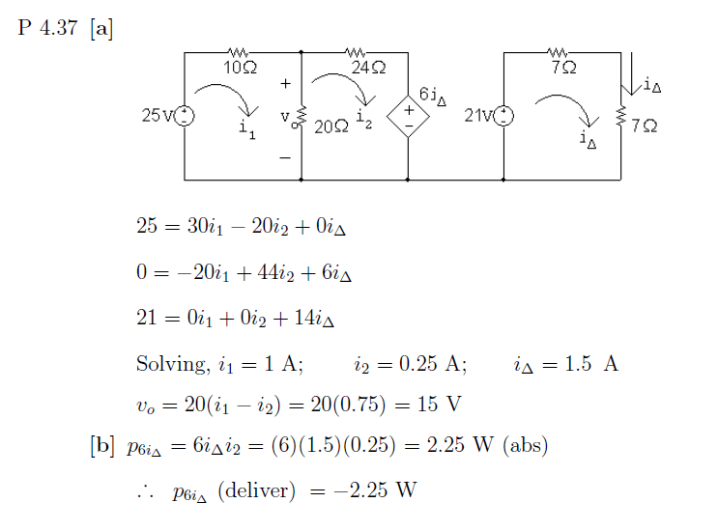
Math Problem Practice:
Reference: Nilsson_Exercise_Problem_4.37

Slide 22
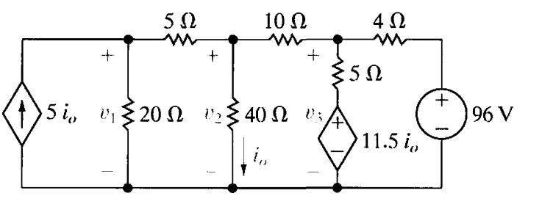
Math Problem Practice:
Find the mesh currents.

Slide 23
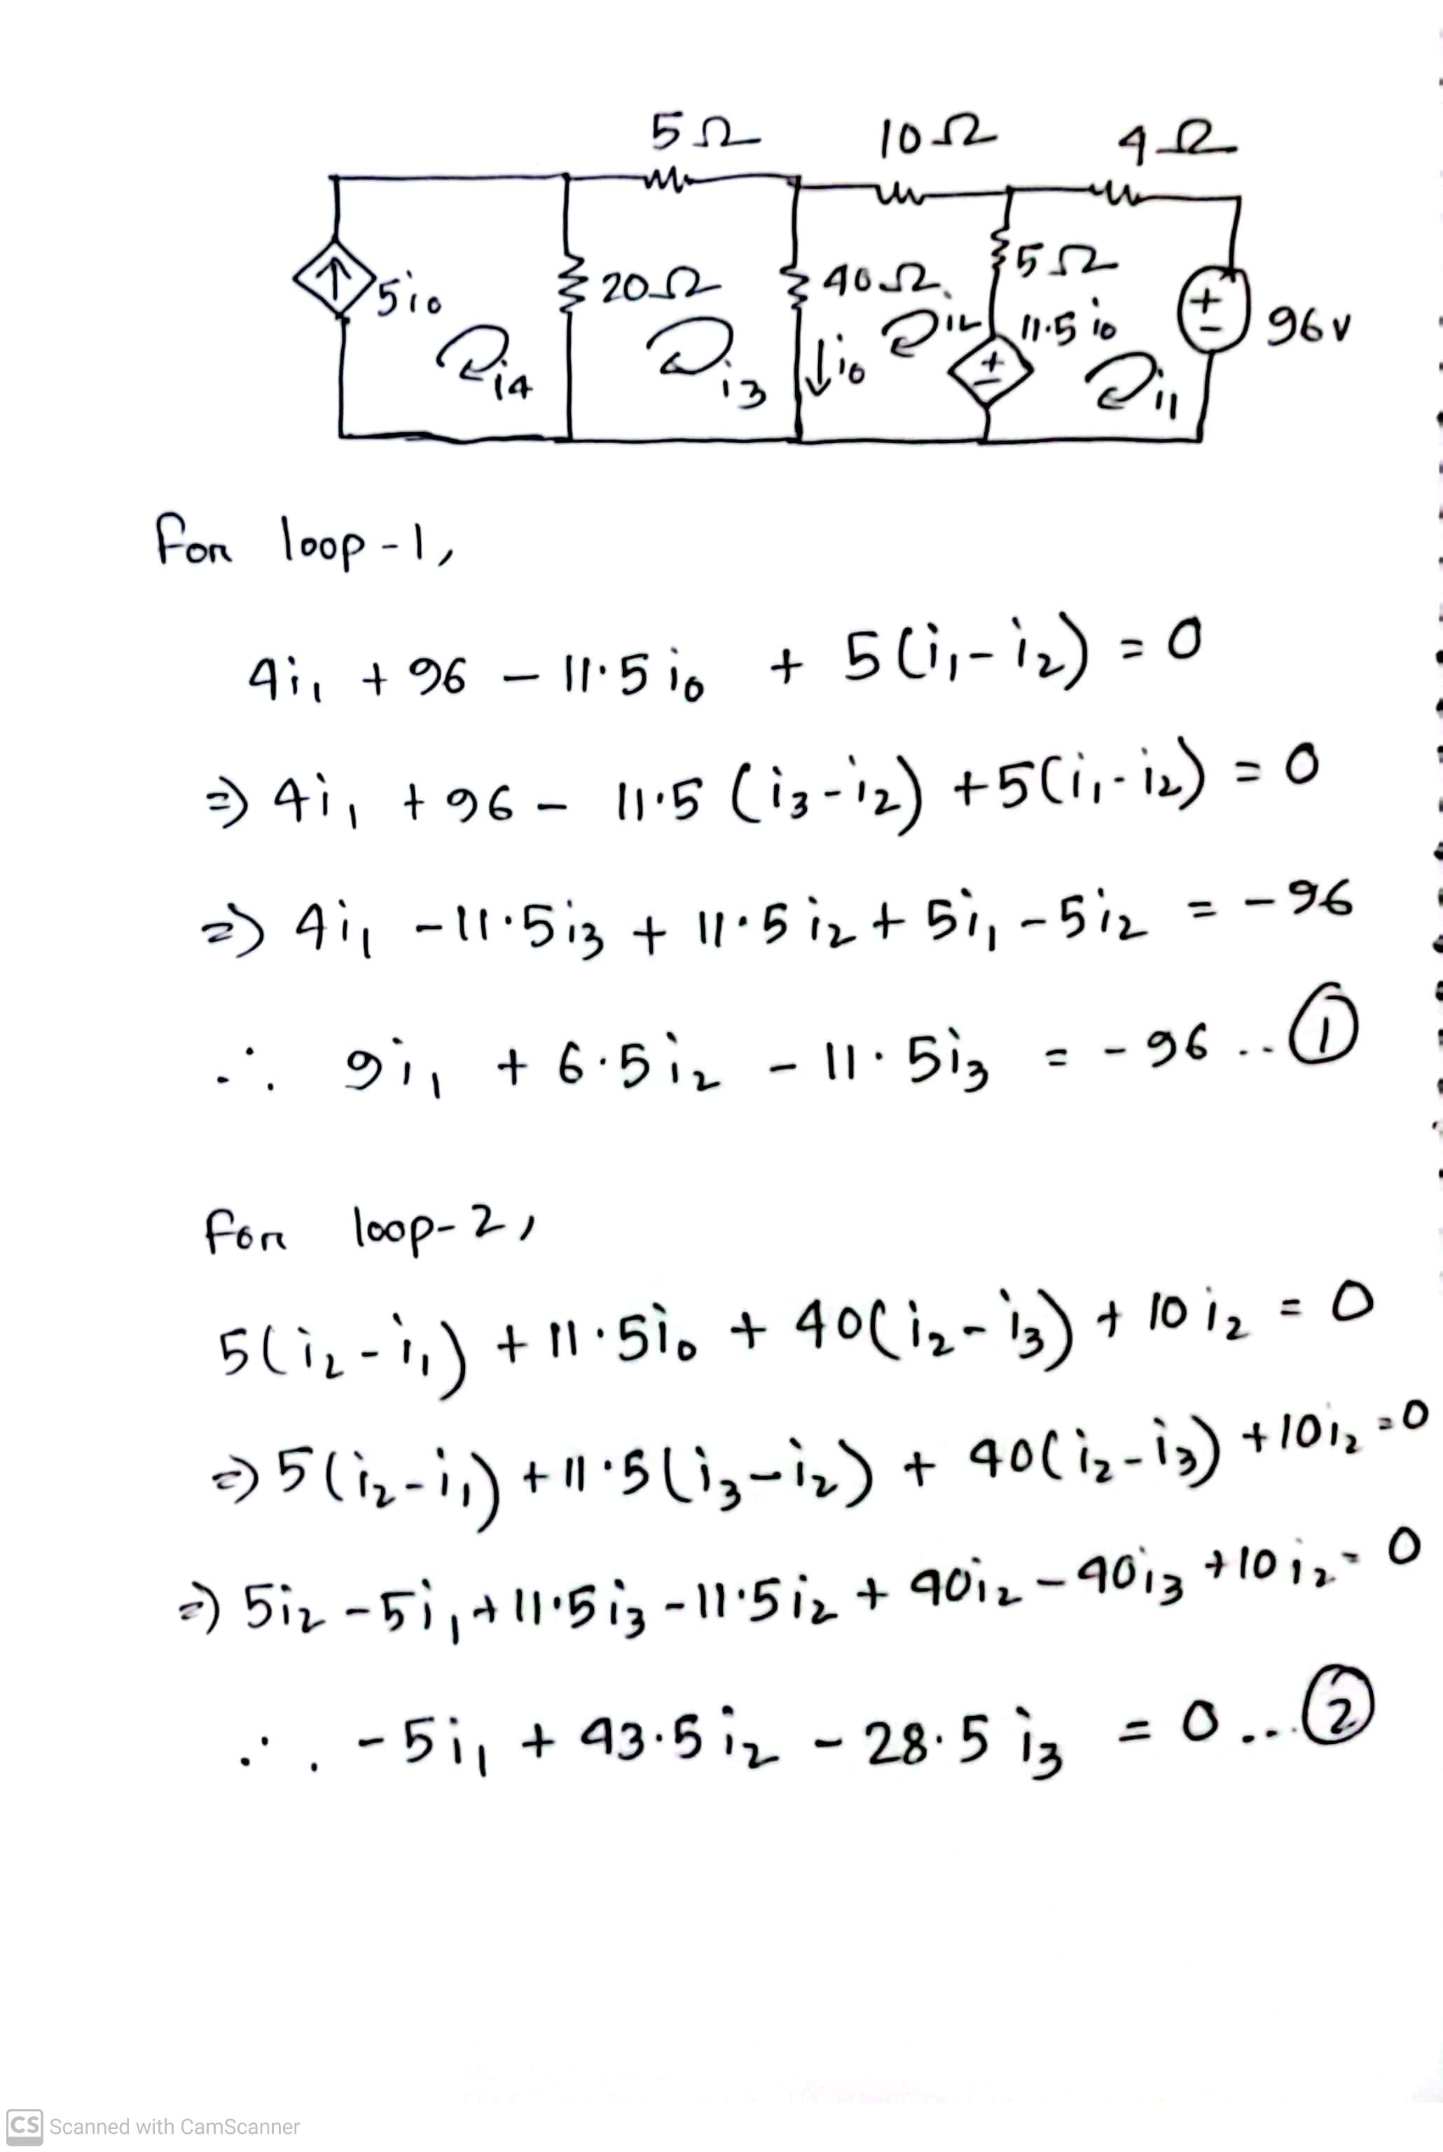
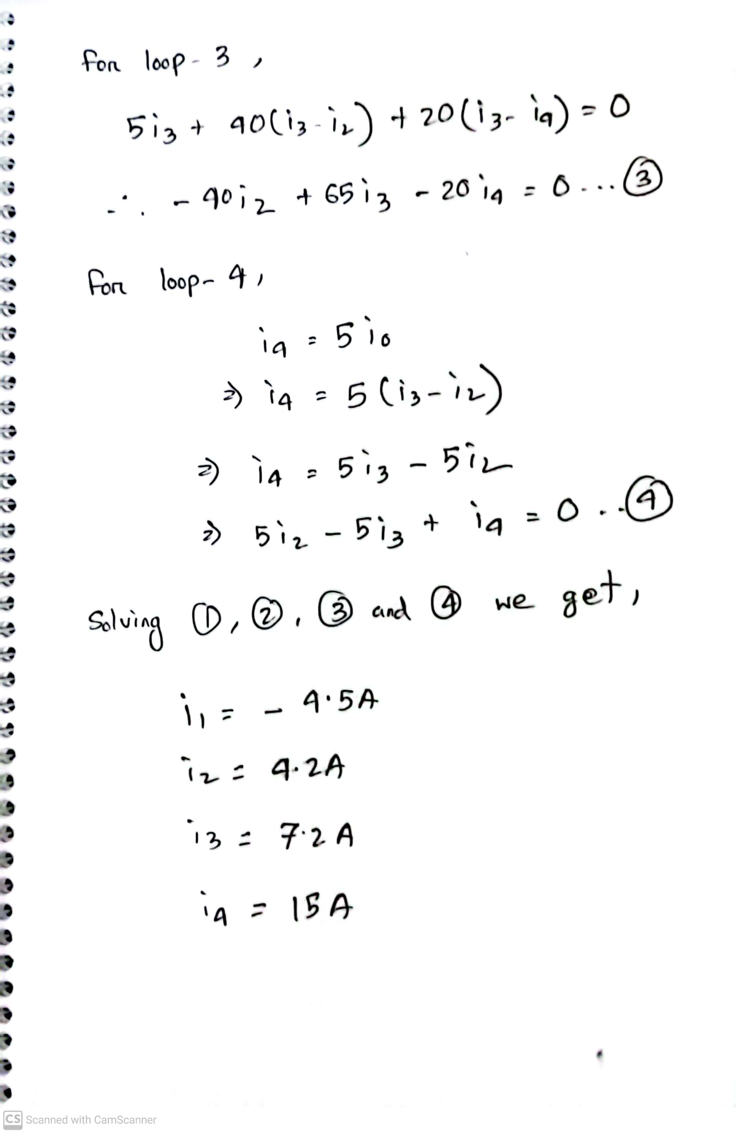
Math Problem Practice:

Slide 24
Math to Practice from the Book for Exam
Chapter 3
Example:
3.1, 3.2, 3.5, 3.6, 3.7
Practice Problem:
3.1, 3.2, 3.5, 3.6, 3.7
Problem:
3.2 to 3.9, 3.12, 3.14, 3.19, 3.38, 3.40, 3.41, 3.42, 3.43, 3.44, 3.45, 3.46, 3.48, 3.50, 3.51, 3.52, 3.55, 3.58, 3.63
N:B: Please note that the supernode concept is not in the present syllabus!

Slide 25
Thank You

